Slide 1
"Queueing Theory with Priority Scheduling: Preemptive vs Non-Preemptive Models"
Comparative Analysis of Queue Length and Waiting Time

Slide 2
Introduction
Motivation: To compare how different scheduling strategies impact the efficiency of queueing systems, specifically for systems with priority levels.
Problem Statement: Traditional M/M/c queue models do not account for job priorities, so we extend this to analyze Preemptive and Non-Preemptive priority scheduling.
Objective: Compare queue lengths and waiting times for high-priority and low-priority tasks under different scheduling rules.
Notes:
Aim of the Project: The project aims to explore and compare two types of priority scheduling systems—Preemptive and Non-Preemptive Queueing Models. The goal is to understand how introducing priority levels affects system performance, focusing on metrics like queue lengths, waiting times, and overall system efficiency.
Motivation: Queue management systems are crucial in many real-world scenarios like customer service, computer processing, and telecommunications. Improving queue efficiency through optimal scheduling mechanisms can lead to faster service times, reduced waiting, and better resource allocation. Priority scheduling is one of the key strategies for handling such systems effectively.

Slide 3
Theoretical Background
M/M/c Queue System: A system with multiple servers (c), where jobs arrive following a Poisson process (M) and are served at exponentially distributed times (M).
Priority Scheduling: In systems with job priorities, high-priority tasks are given preference over lower-priority tasks.
Preemptive Scheduling: High-priority tasks can interrupt lower-priority tasks that are in service.
Non-Preemptive Scheduling: Once a task (low or high priority) starts service, it cannot be interrupted, even if a high-priority task arrives.
Notes:
M/M/c Model The M/M/c Model is a fundamental concept in queueing theory. Here’s a brief overview:
M/M/c stands for Markovian arrivals, Markovian service times, and ‘c’ servers.
Markovian Arrivals: Jobs arrive according to a Poisson process, meaning the time between arrivals is exponentially distributed.
Markovian Service: Service times also follow an exponential distribution.
‘c’ Servers: The system has ‘c’ service desks or servers available to handle incoming jobs.
This model helps analyze systems where multiple servers handle tasks, providing insights into performance metrics like average wait times and queue lengths.
.
In preemptive priority scheduling, a server can interrupt the service of a lower-priority customer if a higher-priority customer arrives. The interrupted customer is placed back in the queue and will be served later. Here are the key characteristics:
Example: Consider an emergency room in a hospital. If a patient with a life-threatening condition arrives, they will be treated immediately, even if it means interrupting the treatment of other patients with less critical conditions.
In non-preemptive priority scheduling, once a server (or processor) starts serving a customer (or task), it will continue to serve that customer until the service is complete. The server does not switch to a higher-priority customer even if one arrives during the service. Here are the key characteristics:
Example: Imagine a customer service desk where once an agent starts helping a customer, they continue until the issue is resolved, regardless of how urgent other waiting customers’ issues might be.
Comparison
Efficiency: Preemptive scheduling can be more efficient in handling urgent tasks but may lead to higher overhead due to context switching.
Fairness: Non-preemptive scheduling is simpler and fairer to tasks once they start being served, but it might delay urgent tasks.
Complexity: Preemptive scheduling is more complex to implement due to the need for handling interruptions and context switching.
Both methods have their advantages and are chosen based on the specific requirements of the system being designed.

Slide 4
Simulation Setup
The results of the simulation are presented through two sets of scenarios, each illustrating the behavior of the queueing system under preemptive and non-preemptive scheduling policies. The analysis focuses on queue lengths and waiting times for high and low priority customers across different parameter settings.
The common parameters are:
Service Rate: 3
Total Simulation Time: 150
Notes:
In the simulation, both High-Priority and Low-Priority tasks are introduced. We vary the arrival rates for each priority level while keeping the service rate and simulation time constant. The service rate reflects how fast tasks are completed, while the arrival rate influences how quickly new tasks enter the system.
Parameters Used:
High-priority arrival rates: Tested with various values (e.g., 0.2, 0.4).
Low-priority arrival rates: Tested with various values (e.g., 0.2, 0.8).
Service rate: Held constant across simulations (e.g., 3).
Simulation time: 150 units of time.

Slide 5
Simulation Setup-1(figure-1)
Parameters:
High Priority Arrival Rate: 0.2
Low Priority Arrival Rate: 0.8
Non-Preemptive Results:
High Priority: Average Waiting Time: 1.8235 ; Average Queue Length: 0.42
Low Priority: Average Waiting Time: 51.775 ; Average Queue Length: 43.92
Preemptive Results:
High Priority: Average Waiting Time: 0.013333 ; Average Queue Length: 0.013333
Low Priority: Average Waiting Time: 45.1133 ; Average Queue Length: 45.1133

Slide 6
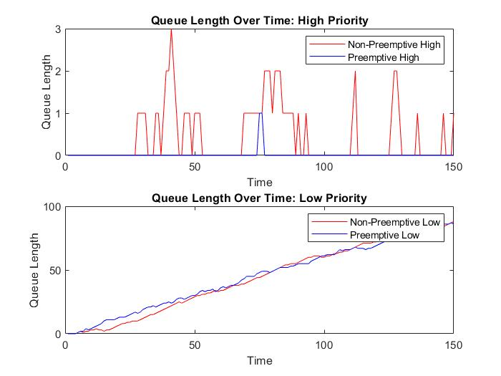
Results: Performance Comparison of Preemptive vs Non-Preemptive Scheduling-1
High Priority: Preemptive scheduling dramatically reduces the waiting time for high-priority customers (from 1.8235 to almost zero), as they are given immediate service over low-priority customers.
Low Priority: In contrast, the waiting time for low-priority customers is slightly higher in the preemptive system, showing the trade-off where lower-priority tasks face longer delays.
Notes:
Graph Analysis:
In the top graph, high-priority customers experience short queue lengths in both systems, but preemptive scheduling eliminates virtually all waiting.
The low-priority customers, seen in the bottom graph, face consistently longer queues and waiting times, especially in the non-preemptive system, which struggles to handle the high influx of low-priority arrivals.
Parameters:
High Priority Arrival Rate: 0.2
Low Priority Arrival Rate: 0.8
Non-Preemptive Results:
High Priority: Average Waiting Time: 1.8235 ; Average Queue Length: 0.42
Low Priority: Average Waiting Time: 51.775 ; Average Queue Length: 43.92
Preemptive Results:
High Priority: Average Waiting Time: 0.013333 ; Average Queue Length: 0.013333
Low Priority: Average Waiting Time: 45.1133 ; Average Queue Length: 45.1133

Slide 7
Simulation Setup-2(figure-2)
Parameters:
High Priority Arrival Rate: 0.4
Low Priority Arrival Rate: 0.2
Non-Preemptive Results:
High Priority: Average Waiting Time: 10.5789 Average Queue Length: 4.48
Low Priority: Average Waiting Time: 9Average Queue Length: 10.1133
Preemptive Results:
High Priority: Average Waiting Time: 6.8133Average Queue Length: 6.8133
Low Priority: Average Waiting Time: 16.2867Average Queue Length: 16.2867

Slide 8
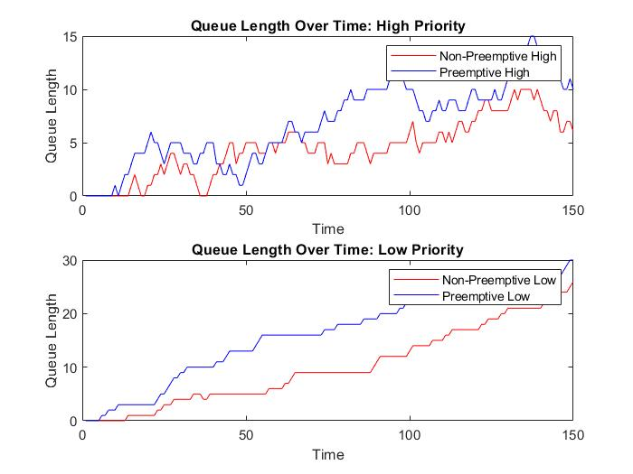
Results: Performance Comparison of Preemptive vs Non-Preemptive Scheduling-2
High Priority: The preemptive system reduces the waiting time for high-priority customers from 10.5789 to 6.8133. This demonstrates that preemptive scheduling is more efficient at prioritizing high-priority customers even with higher arrival rates.
Low Priority: Like the first scenario, low-priority customers suffer in the preemptive system, with an increase in average waiting time from 9 to 16.2867.
Graph Analysis:
Notes:
The top graph for high-priority customers shows that, in the non-preemptive system, queue lengths grow more erratically, while in the preemptive system, the queues are better managed with smaller bursts. For low-priority customers (bottom graph), both systems exhibit a growing queue over time, but the preemptive system consistently shows a longer queue for low-priority tasks, reflecting the trade-off inherent in prioritization.

Slide 9
Analysis:
High-Priority Tasks:
Preemptive scheduling greatly reduces waiting time and queue length for high-priority tasks. These tasks are served almost immediately with minimal delay.
Low-Priority Tasks:
Preemptive scheduling severely penalizes low-priority tasks, leading to long queue lengths and waiting times as they are frequently interrupted by high-priority tasks.
Non-preemptive scheduling benefits low-priority tasks, with predictable service times and shorter waiting times compared to preemptive.

Slide 10
Conclusion
Preemptive Scheduling: Ideal for systems where high-priority tasks must be served immediately and cannot tolerate delays (e.g., emergency services).
Non-Preemptive Scheduling: Better for balanced service across priorities, particularly in systems where fairness or equal service is crucial.

